Slide 1
ROSE RIVERS NURSING LEADERSHIP DEVELOPMENT FELLOWSHIP
Allison Peters, BSN, RN, CNOR
2009 Fellowship Graduate

Slide 2

Some Lessons Learned
Out of the Box Thinking
Examples of Leadership
Difference Between Leaders & Managers

Slide 3
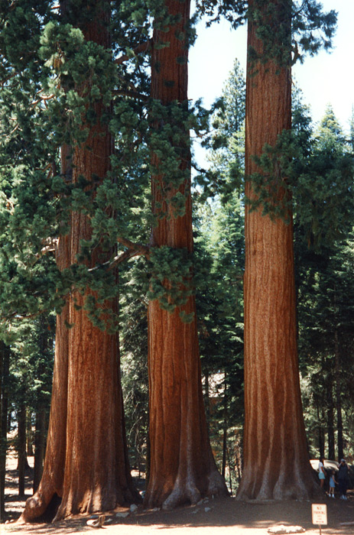
Number One Thing You Need to Be a Leader?
  Followers
    Faith
    Smile
    Team

Slide 4




Thank You
ROSE
Ginger
betty
mary

Slide 5
Reference
Geddes, A (n.d) Photographic collections. Retrieved October 29, 2010 from yahoo.com image search
Mariano, C (July 17, 2010) So you want to be a leader? Great! The art and science of leadership. AORN Leadership Conference. Denver Marriott City Center; Denver, CO
University of Florida (2009) Leadership Development Fellowship. Rose Rivers, Betty Jax, Ginger Pesata, Mary Beasley

