Slide 1
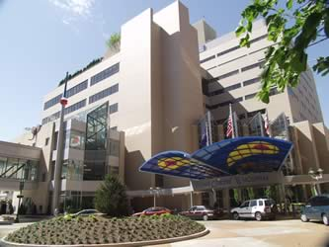
Quality Innovations Hospital
Surgical Services

Slide 2


Quality Innovations Hospital
A 700 bed (25 Suite O.R.) teaching hospital with Magnet status
Advanced, visionary, progressive, evidence based practice
Holistic, quality, patient & family centered care
Collaboration throughout all units to preserve continuity of care

Slide 3

Our Surgical Team
Chief Nurse Executive
Nurse Manager
Clinical Nurse Specialists
Clinical Nurse Specialist
Nursing Educator
Charge Nurses
Staff Nurses (Circulators)
Surgical Technologists
Patient Support Technicians
Staff Nurses (Team Leaders)
Anesthesia Technicians

Slide 4

Mission
The mission of the Surgical Services Department at Quality Innovations Hospital is to provide the best competent, holistic, evidenced based care, utilizing state of the art technology and to responsibly maintain the position as an industry leader in the model of traditional caring.

Slide 5

Vision
Purpose
Goals
Values
Balanced continued commitment of care to the poor and to those in most need with the presentation of highly specialized services to a broad community
Encouraging a work environment where each person is respected and has the opportunity for personal as well as professional growth
Fostering a culture of discovery and support health science research
Upholding unwavering strength and commitment demonstrated by staff, physicians, volunteers, community partners and friends who support the mission

Slide 6

Patient Centered Care
Accountability
Creativity
Service
Wisdom
C
O
R
E
V
A
L
U
E
S

Slide 7
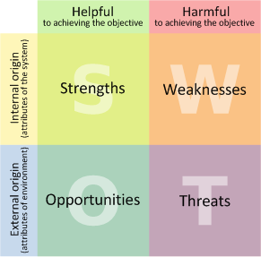
S.W.O.T. Analysis

Slide 8

Strengths
Providing quality, state of the art care for patients
Magnet facility
Funded by state, national/local agencies and charity
Community hospital ‘feel’ in a teaching environment
Ability to treat rare/difficult disease processes

Slide 9

Weaknesses
Transportation to hospital and parking for patients and staff
Stronger advertising campaign
May be viewed as a ‘state’ run hospital compared to private (for profit) facility

Slide 10

Opportunities
Teaching physicians, surgeons, nurses, technicians, and auxiliary staff the principles of excellent practice including care of patients and each other to take into their future practices
Learning new and cutting edge technology
Preparing physicians to diagnose and treat disease
University environment
Attainment of many available funds

Slide 11

THREATS
Loss of funding and economic cutbacks (multi governmental level)
Retaining competitive salaries for professors
Unknown changes in healthcare
Maintaining magnet status

Slide 12

Success Plan
Proven track record of patient satisfaction via anonymous, frequent survey
Motivation of staff education through reimbursement and advancement opportunities
Implementation of Lean Six Sigma Processes (verified “improvements in quality, customer satisfaction, operational and financial performance” (Fairbanks, 2007).
Implementation of Radio Frequency ID and Wall of Knowledge to maintain high quality service and cost containment

Slide 13
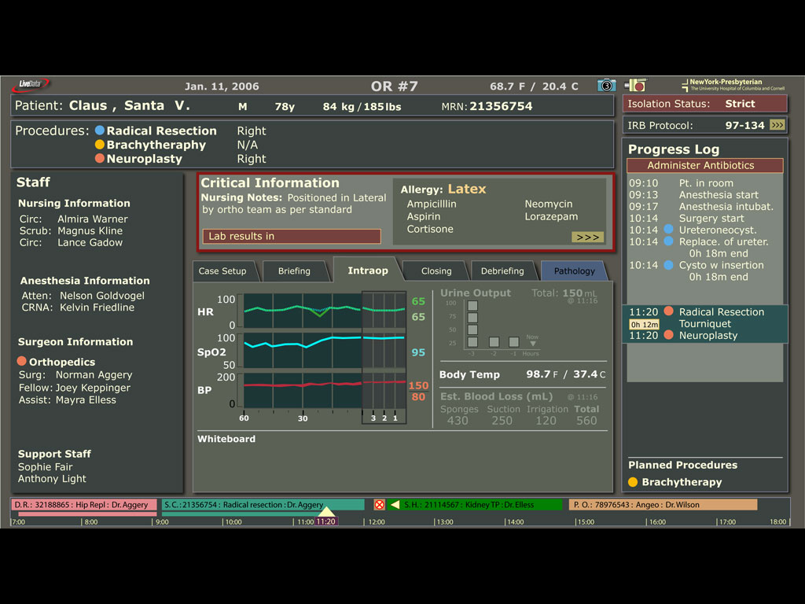
Wall of Knowledge Example

Slide 14

How You Can Help
Providing us with a charitable contribution to help us continue our mission
Why?
This is the hospital you would trust to provide the utmost quality, holistic and innovative care
Model other hospitals look to when designing their organizations
Association with us is synonymous with the success of your business
Help provide jobs for the community maintain economic stability
All donations are tax deductible
For further information please contact:
Allison Peters, BSN, RN, CNOR
        Nurse Manager OR
        Quality Innovations Hospital
        1212 Quality Road
        Anytown, USA
        (555-555-5555) Direct Line
        (555-777-7777) Fax

Slide 15

Reference
American Nurses Credentialing Center (ANCC) (2010) Schedule of fees. Retrieved June 26, 2010 http://www.nursecredentialing.org/Magnet/ApplicationProcess/ApplicationFees.aspx
DeSilets, L., & Dickerson, P. (2008). SWOT is useful in your tool kit. Journal of Continuing Education in Nursing, 39(5), 196-197. Retrieved from CINAHL Plus with Full Text database
Fairbanks, C. (2007). Using six sigma and lean methodologies to improve OR throughput. AORN Journal, 86(1), 73-82. Retrieved from CINAHL Plus with Full Text database.
Finkler, S.A., Kovner, C.T. & Jones, C.B. (2007) Financial management: For nurse managers and executives (3rd ed) St. Louis, MO: Saunders
Healthcare Financial Management Association (HFMA) (n.d.) Operating room per minute cost analysis. Retrieved March 18, 2010 from http://www.hfma.org/publications/revenuecycle_newsletter/exclusives/RCS_WebEx0109.htm
Suberman, A., & Brzezinski, P. (n.d.) Creating the wall of knowledge at New York Presbyterian Hospital: A case study. Retrieved from www.mdhimss.org/Presentations/wallofknowledge.ppt
Yahoo image search retrieved from www.yahoo.com

